Slide 1
The Black-Scholes
Model
Chapter 14

Slide 2
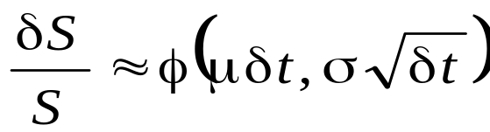
The Stock Price Assumption
Consider a stock whose price is S
In a short period of time of length δt, the return on the stock is normally distributed:
where μ is expected return and σ is volatility

Slide 3
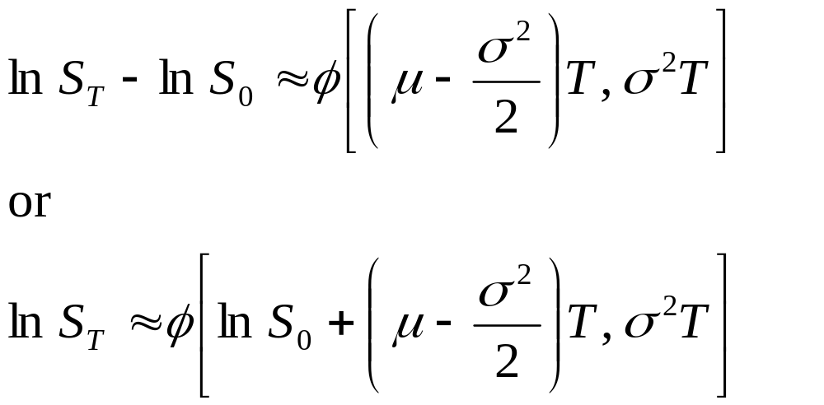
The Lognormal Property
(Equations 13.2 and 13.3, page 278)
It follows from this assumption that
Since the logarithm of S_{T} is normal, S_{T} is lognormally distributed

Slide 4
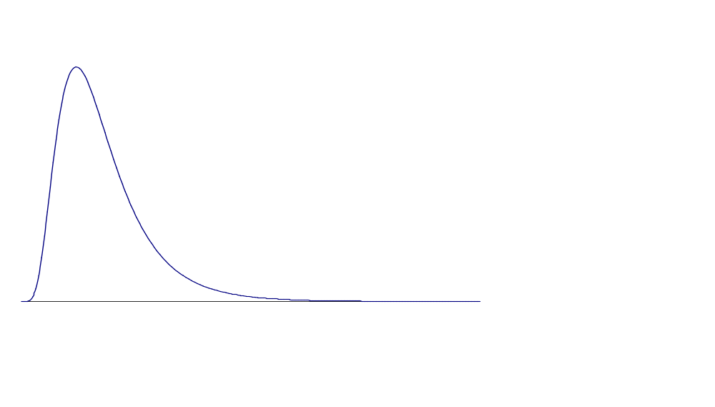
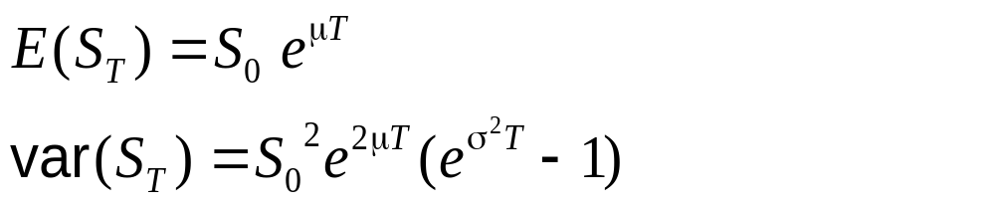
The Lognormal Distribution

Slide 5
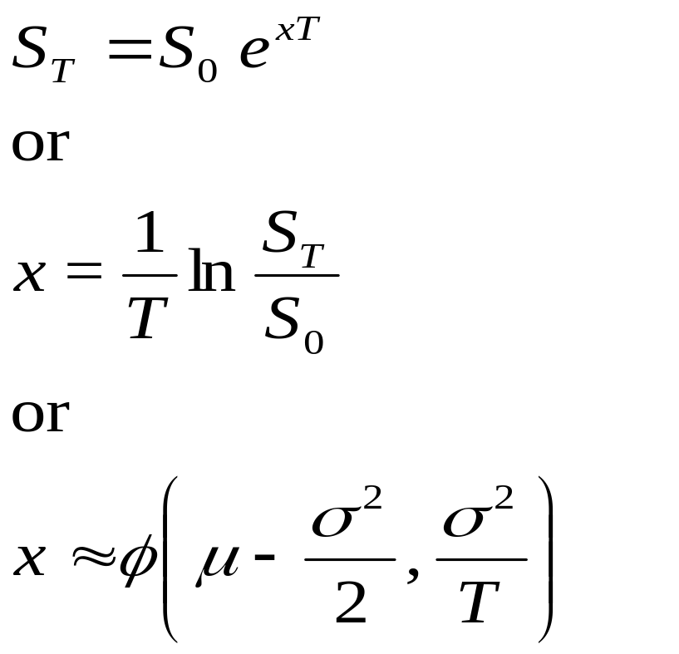
Continuously Compounded Return, x (Equations 13.6 and 13.7, page 279)

Slide 6
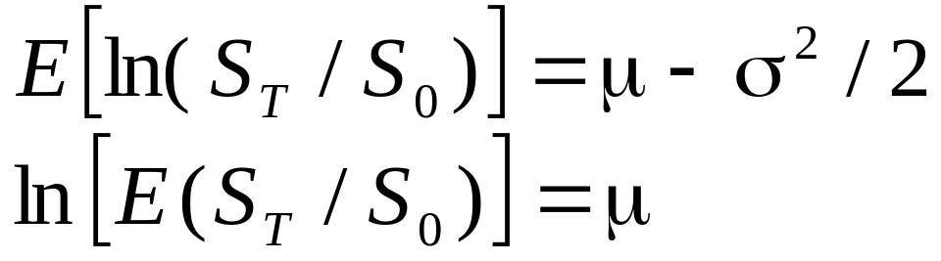
The Expected Return
The expected value of the stock price is S₀e^{μT}
The expected return on the stock is
μ – σ²/2

Slide 7
The Volatility
The volatility of an asset is the standard deviation of the continuously compounded rate of return in 1 year
As an approximation it is the standard deviation of the percentage change in the asset price in 1 year

Slide 8
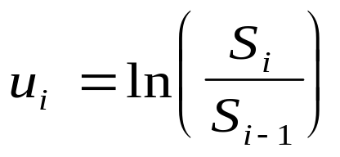
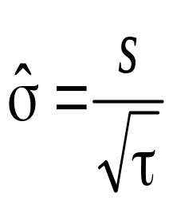
Estimating Volatility from Historical Data (pages 282-284)
Take observations S₀, S₁, . . . , S_{n} at intervals of τ years
Calculate the continuously compounded return in each interval as:
Calculate the standard deviation, s , of the u_{i}´s
The historical volatility estimate is:

Slide 9
The Concepts Underlying Black-Scholes
The option price and the stock price depend on the same underlying source of uncertainty
We can form a portfolio consisting of the stock and the option which eliminates this source of uncertainty
The portfolio is instantaneously riskless and must instantaneously earn the risk-free rate
This leads to the Black-Scholes differential equation

Slide 10
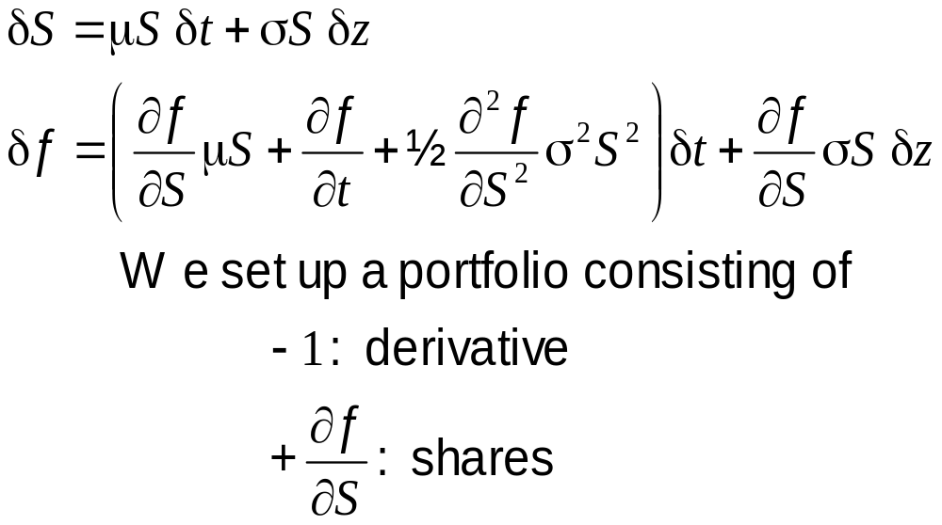
The Derivation of the Black-Scholes Differential Equation

Slide 11
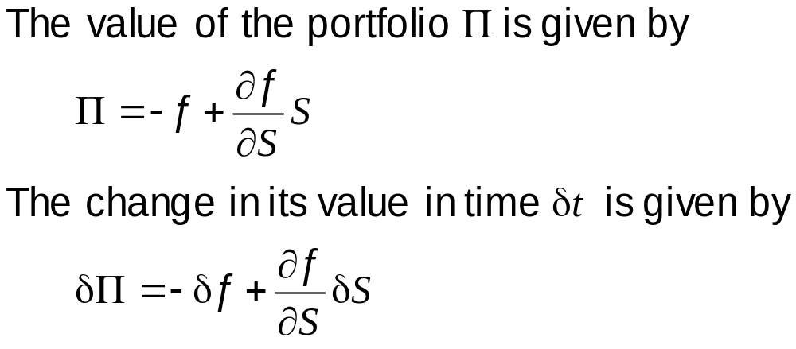
The Derivation of the Black-Scholes Differential Equation continued

Slide 12
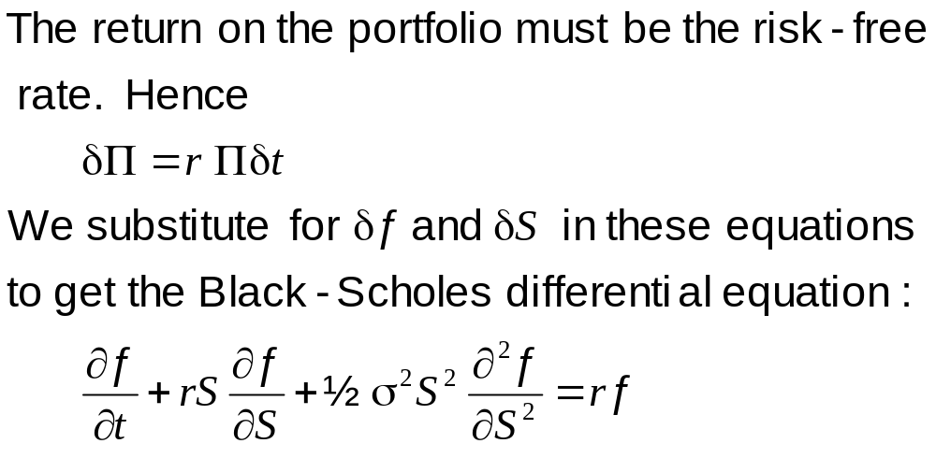
The Derivation of the Black-Scholes Differential Equation continued

Slide 13
The Differential Equation
Any security whose price is dependent on the stock price satisfies the differential equation
The particular security being valued is determined by the boundary conditions of the differential equation
In a forward contract the boundary condition is ƒ = S – K when t =T
The solution to the equation is
ƒ = S – K e^{–r (T – t )}

Slide 14
Risk-Neutral Valuation
The variable μ does not appear in the Black-Scholes equation
The equation is independent of all variables affected by risk preference
The solution to the differential equation is therefore the same in a risk-free world as it is in the real world
This leads to the principle of risk-neutral valuation

Slide 15
Applying Risk-Neutral Valuation
1. Assume that the expected return from the stock price is the risk-free rate
2. Calculate the expected payoff from the option
3. Discount at the risk-free rate

Slide 16
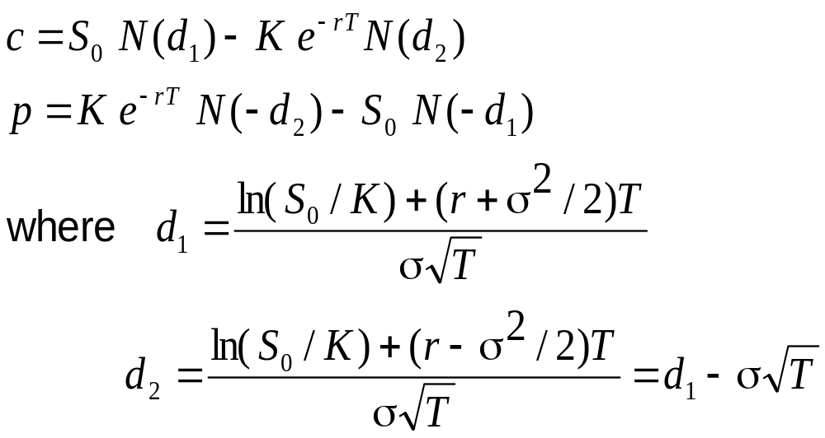
The Black-Scholes Formulas
(See pages 291-293)

Slide 17
Implied Volatility
The implied volatility of an option is the volatility for which the Black-Scholes price equals the market price
The is a one-to-one correspondence between prices and implied volatilities
Traders and brokers often quote implied volatilities rather than dollar prices

Slide 18
Causes of Volatility
Volatility is usually much greater when the market is open (i.e. the asset is trading) than when it is closed
For this reason time is usually measured in “trading days” not calendar days when options are valued

Slide 19
Warrants & Dilution (pp. 294-296)
When a regular call option is exercised the stock that is delivered must be purchased in the open market
When a warrant is exercised new Treasury stock is issued by the company
This will dilute the value of the existing stock
One valuation approach is to assume that all equity (warrants + stock) follows geometric Brownian motion

Slide 20
Dividends
European options on dividend-paying stocks are valued by substituting the stock price less the present value of dividends into Black-Scholes
Only dividends with ex-dividend dates during life of option should be included
The “dividend” should be the expected reduction in the stock price expected

Slide 21
American Calls
An American call on a non-dividend-paying stock should never be exercised early
An American call on a dividend-paying stock should only ever be exercised immediately prior to an ex-dividend date

Slide 22
Black’s Approach to Dealing with
Dividends in American Call Options
Set the American price equal to the maximum of two European prices:
1. The 1st European price is for an option maturing at the same time as the American option
2. The 2nd European price is for an option maturing just before the final ex-dividend date

